Slide 1
I Am I.T. Iowa
Website Proposal
Bailey Borchert & Craig Barkley

Slide 2
Where we saw room for improvement

Slide 3
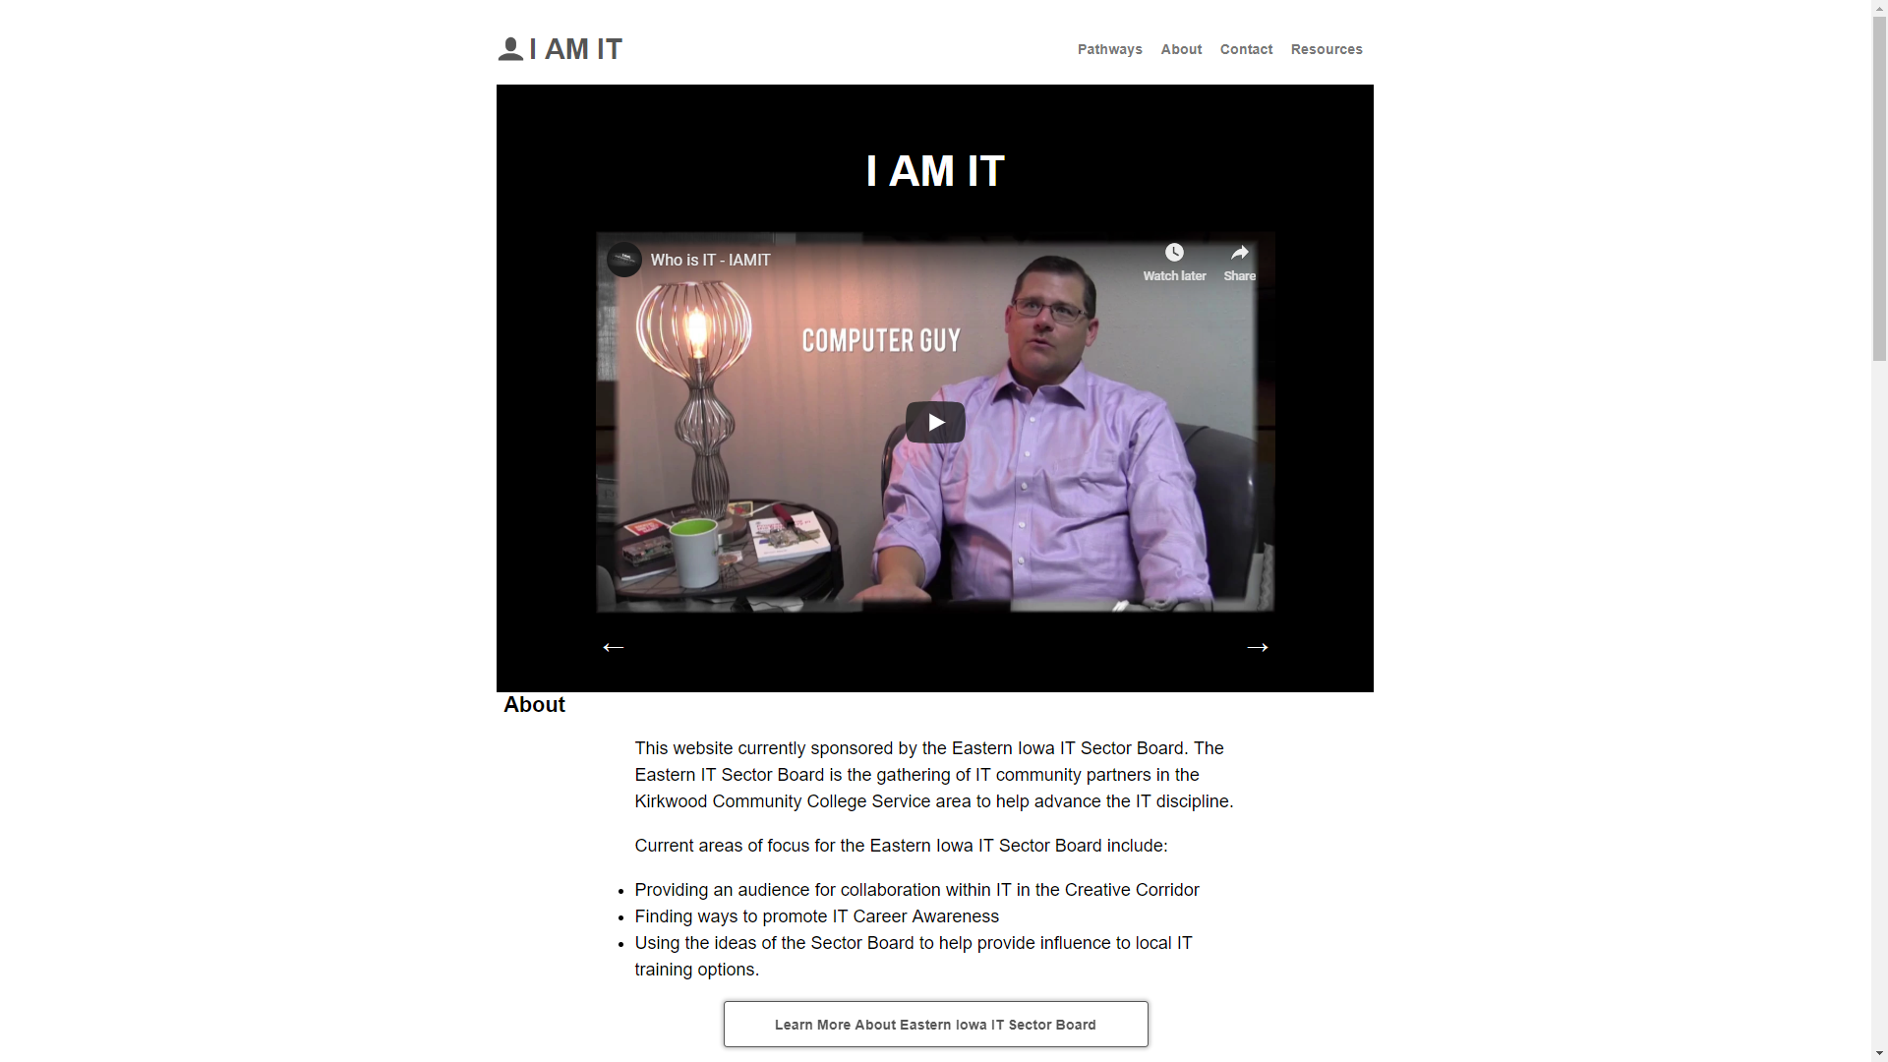
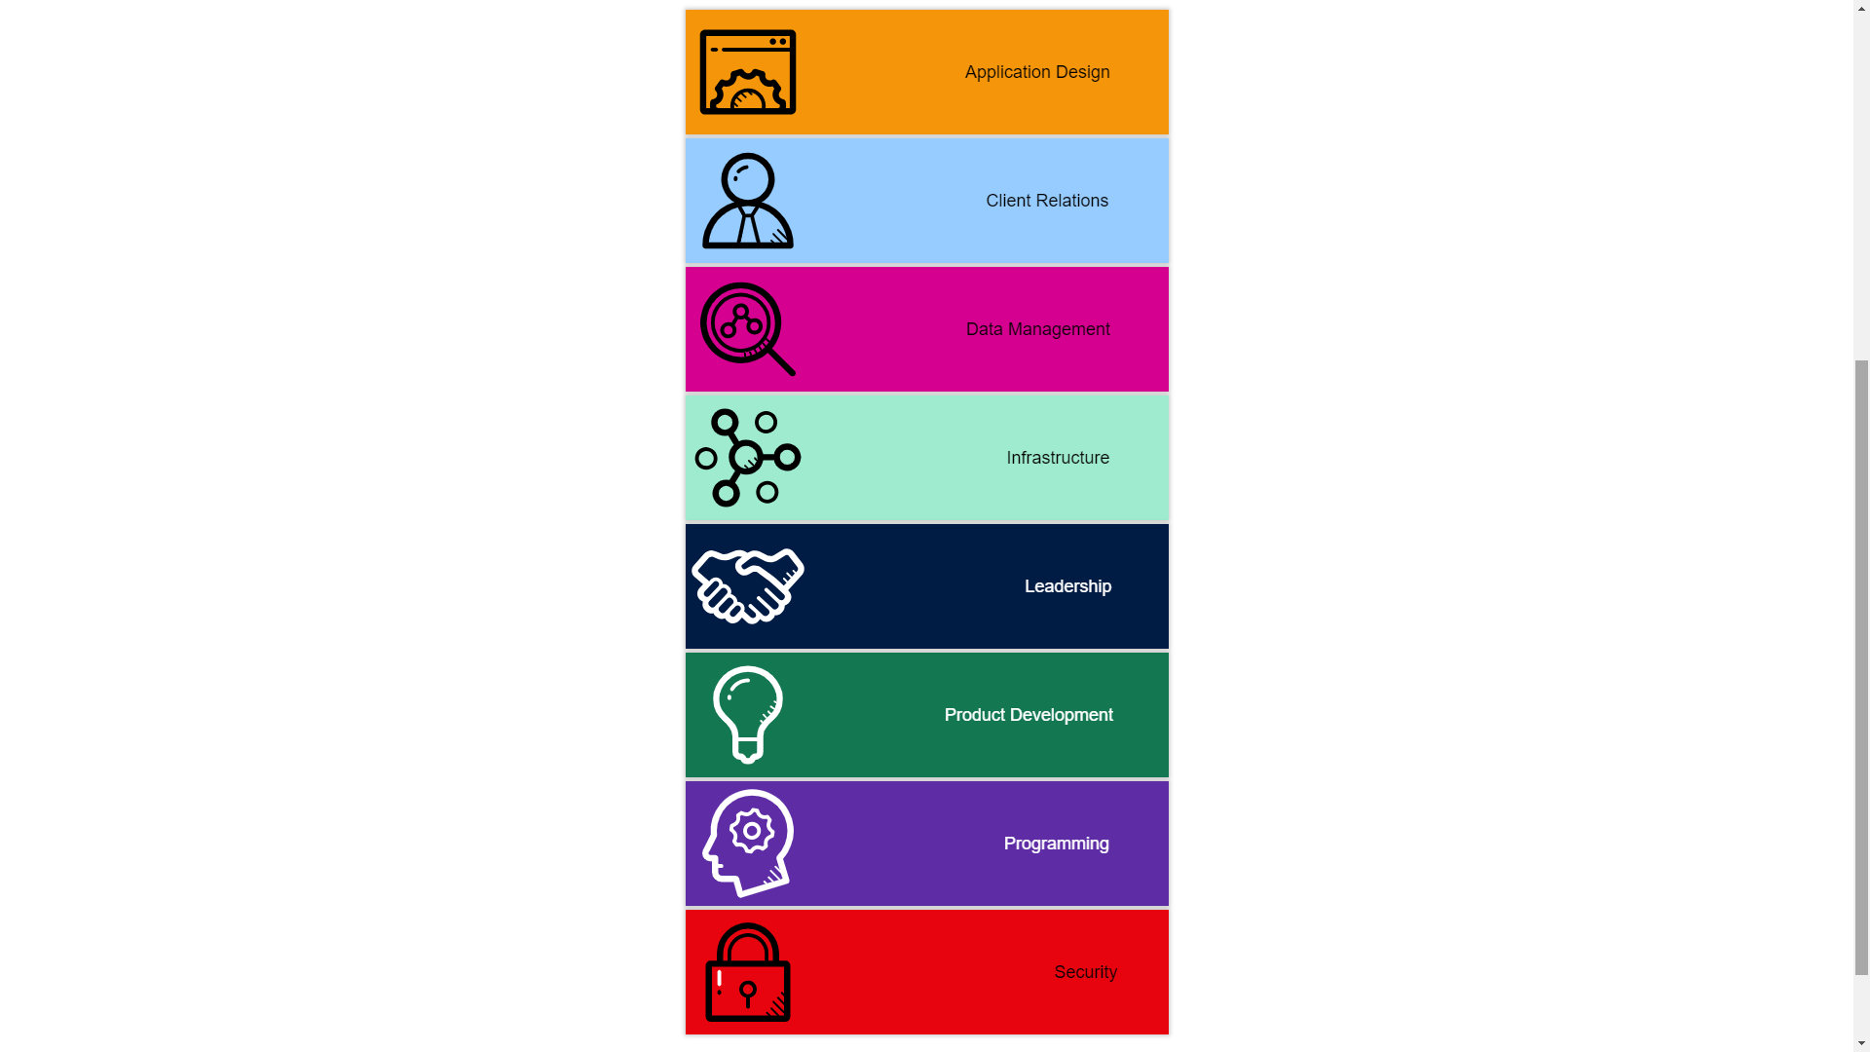
Visual layout

Slide 4
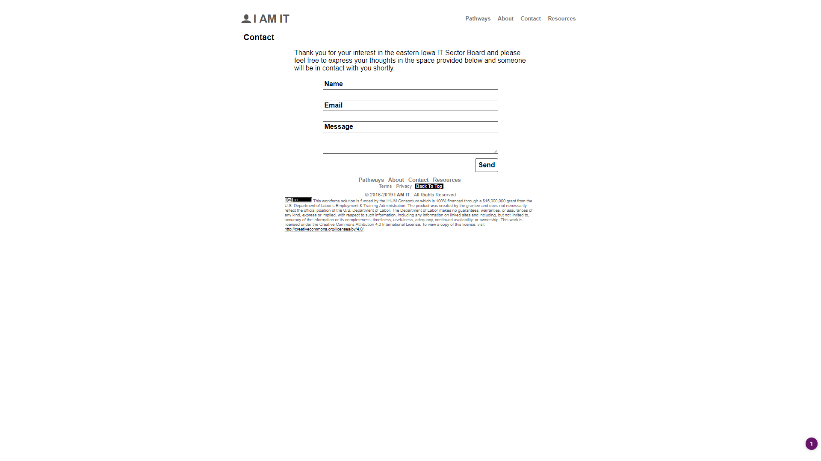
Lack of security

Slide 5
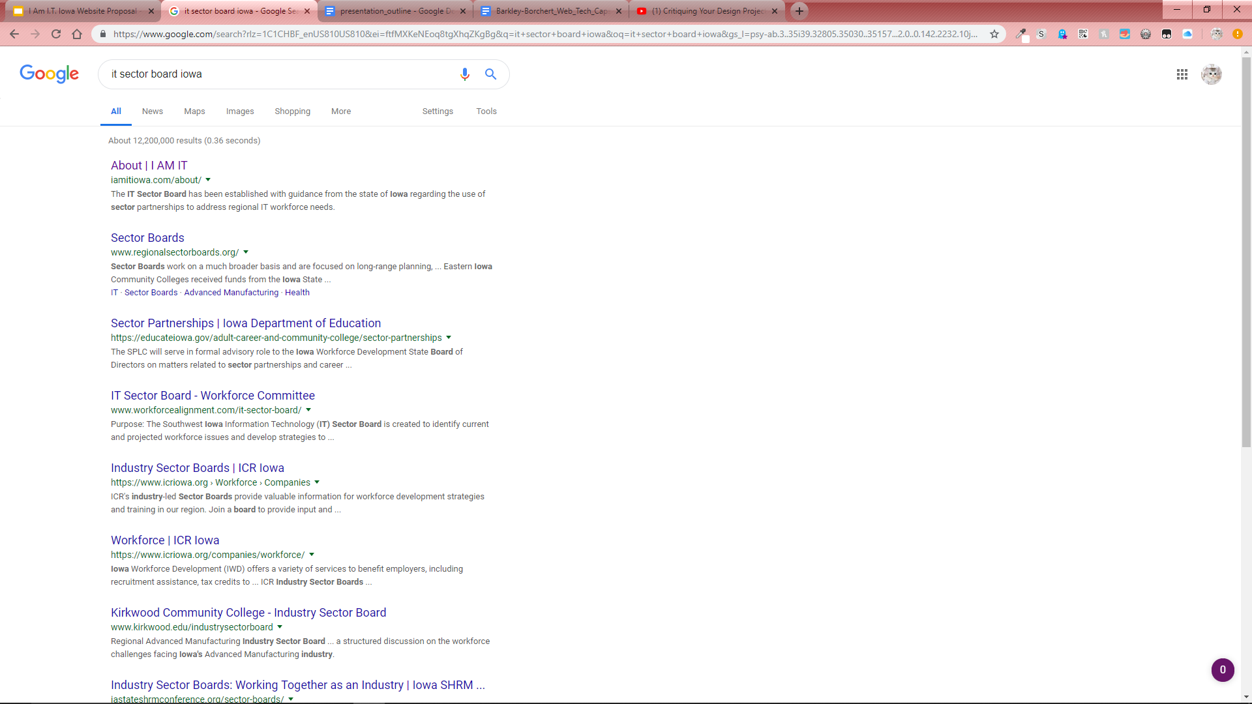
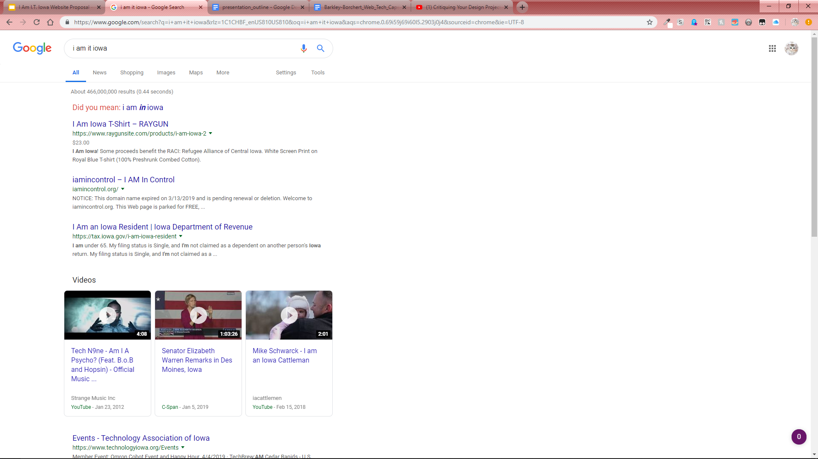

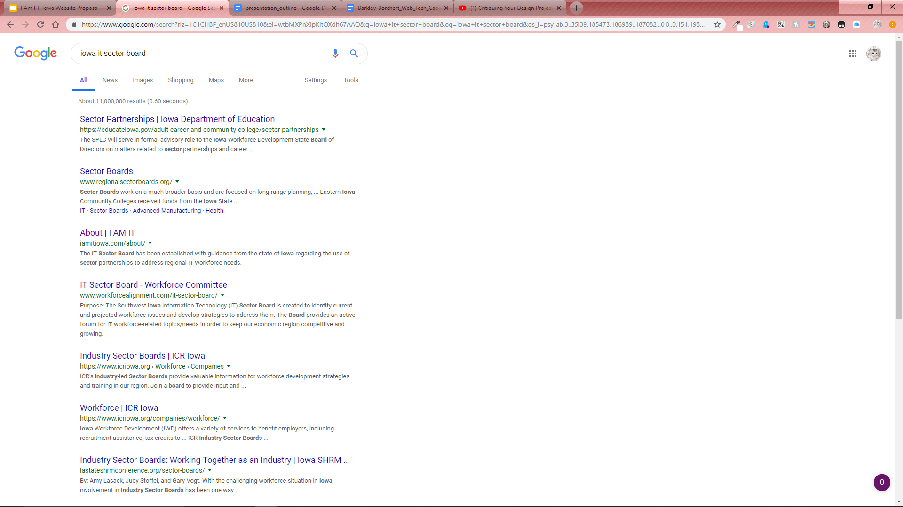
Search engine optimization (SEO)
OK...

Slide 6
Inefficient data storage
No databasing
All information stored directly in web page code

Slide 7
Our plans to make an improved site

Slide 8












Development environment

Slide 9
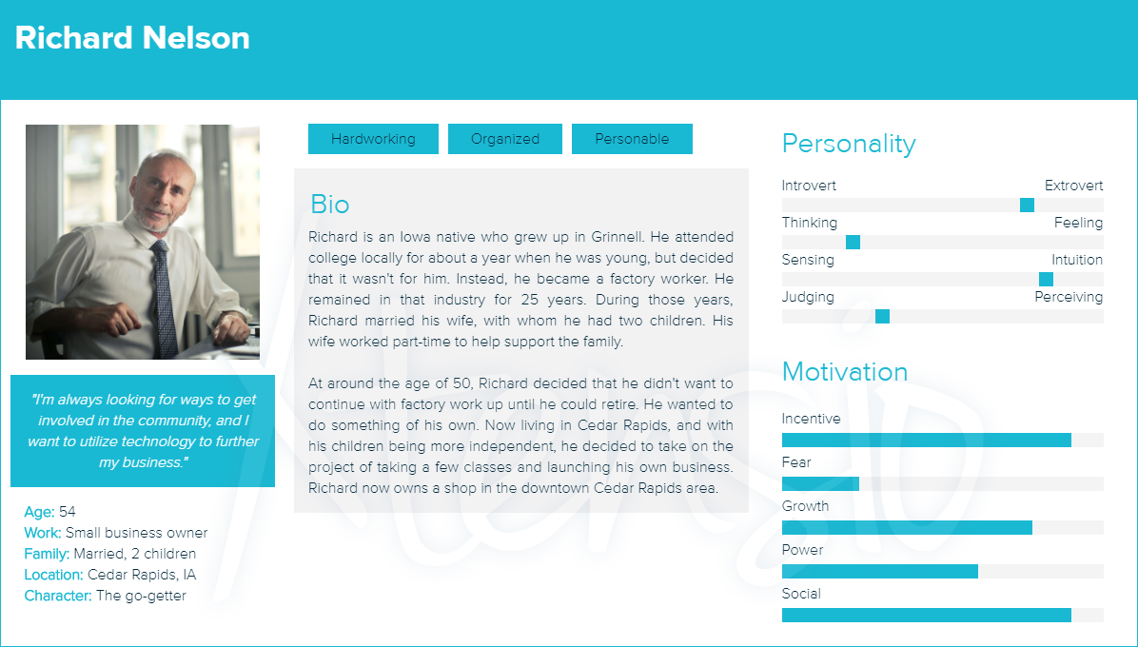
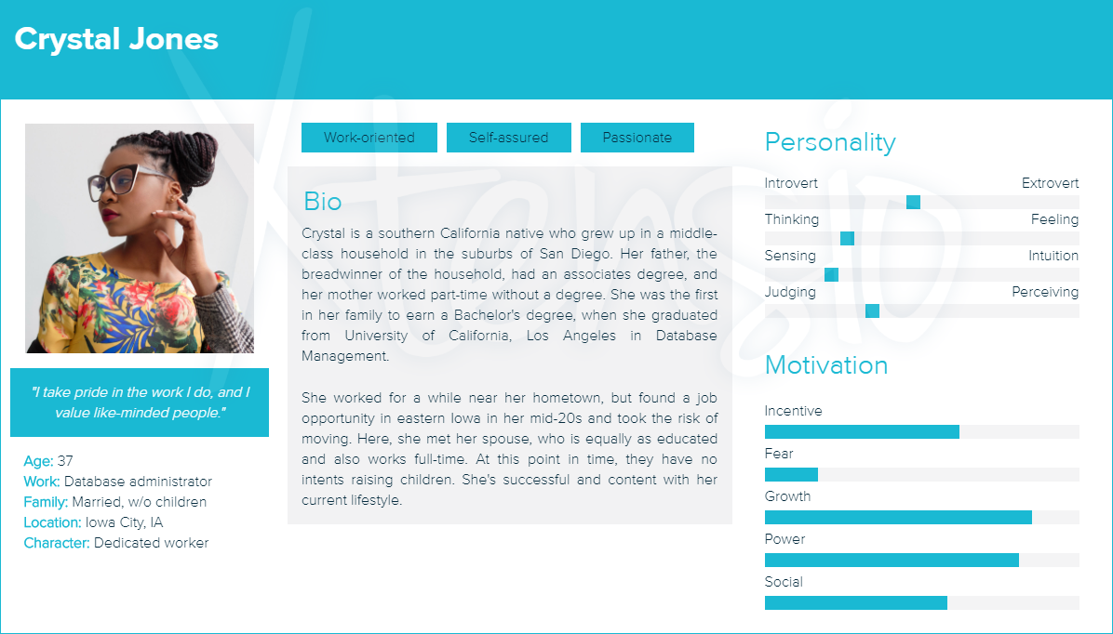
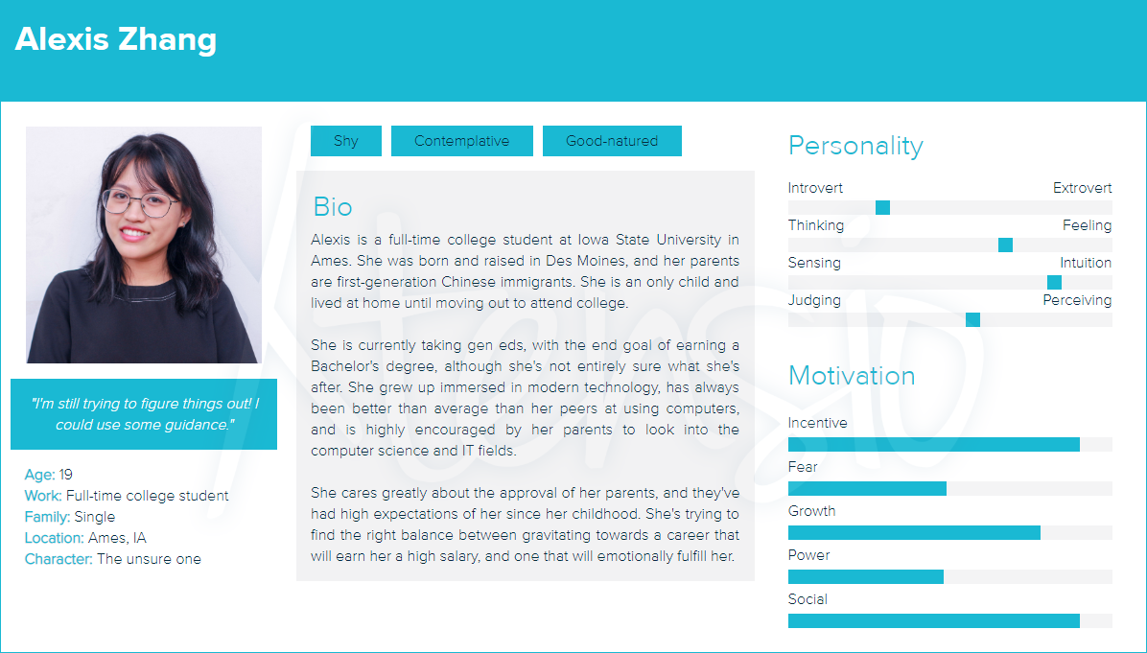
Personas
Who is going to use our site and why?
How can we meet their needs?

Slide 10
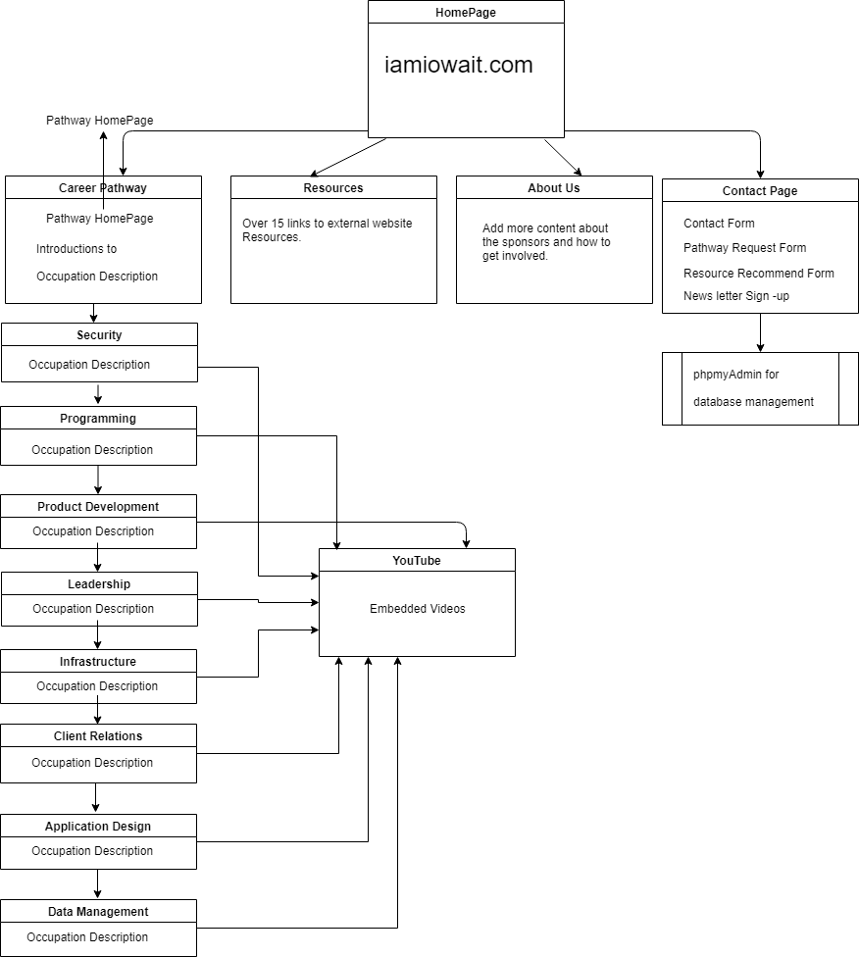
Site diagram
How will users navigate our site through links?

Slide 11
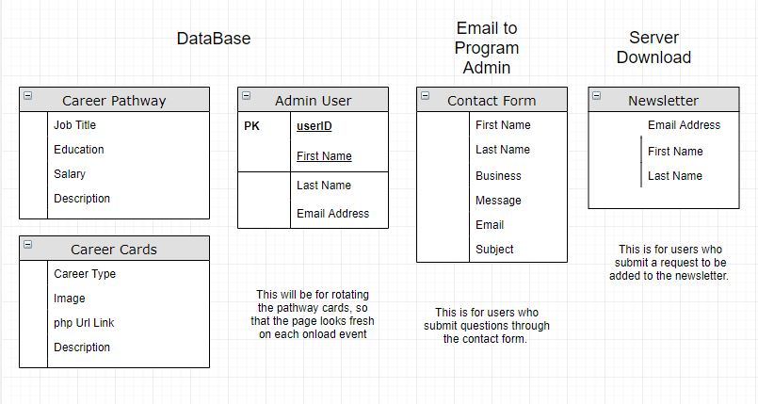
Data Management
How can we use a data to organize site information?

Slide 12
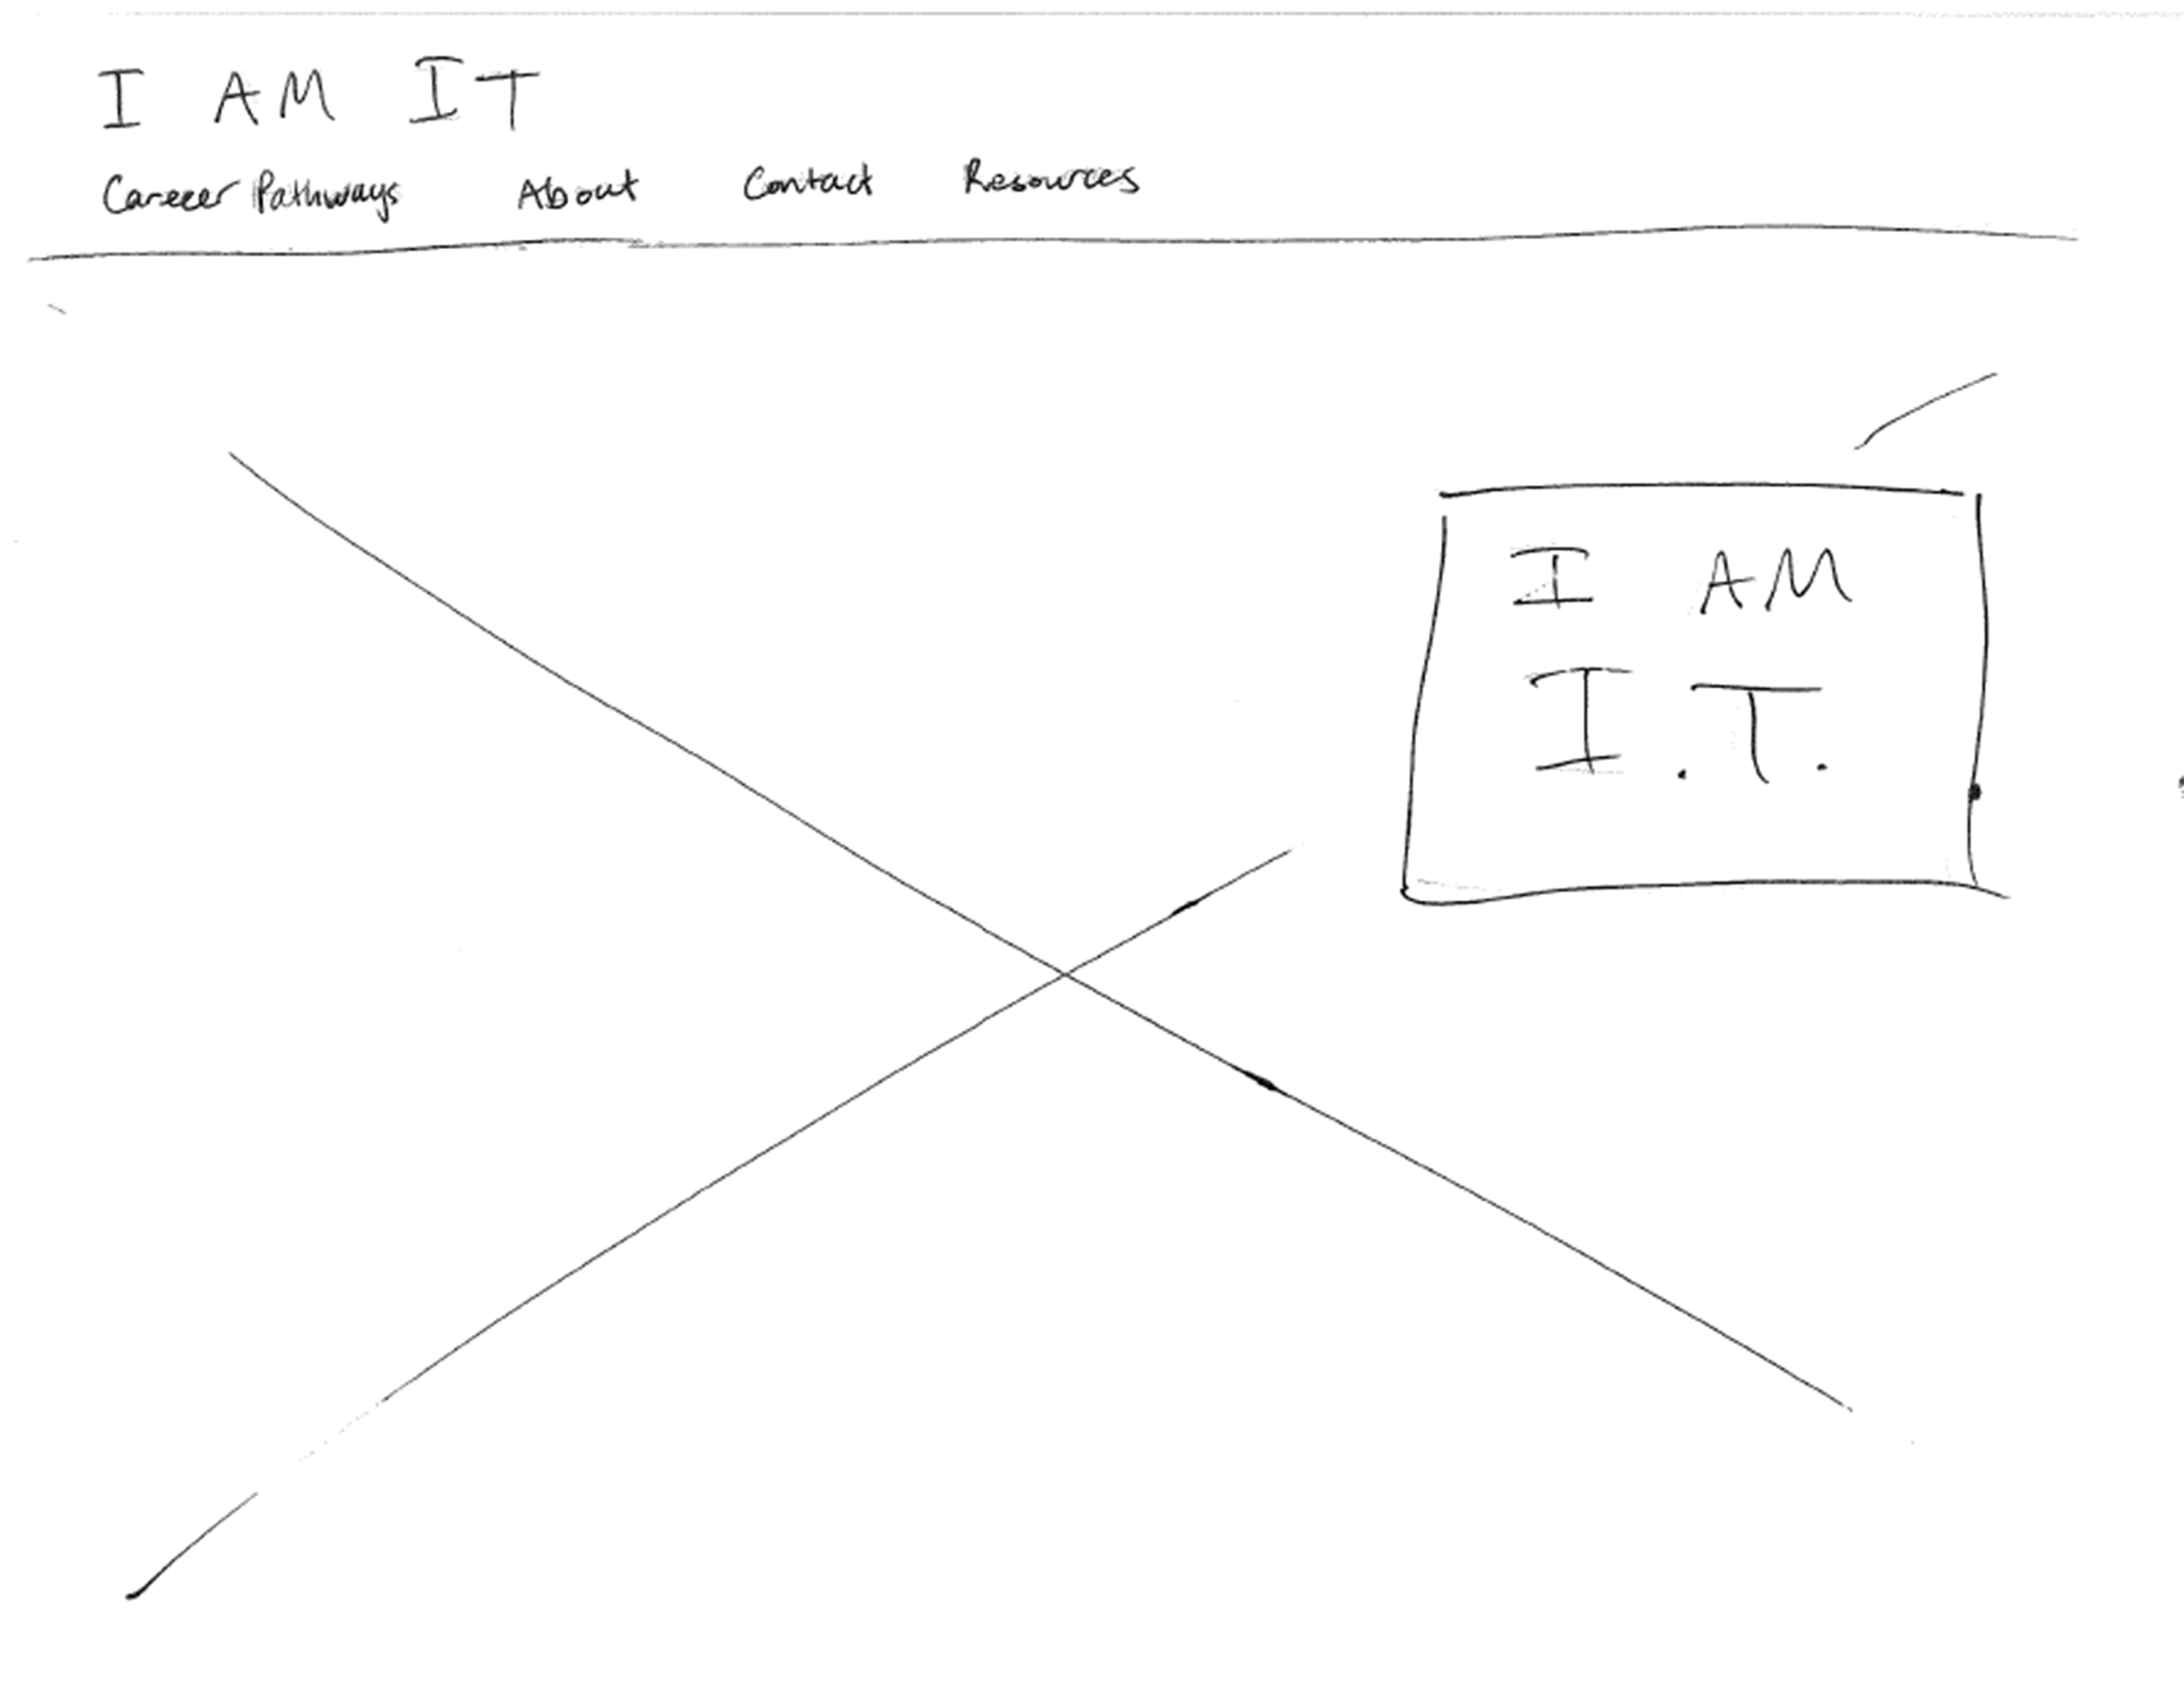
Wireframes - Home page

Slide 13
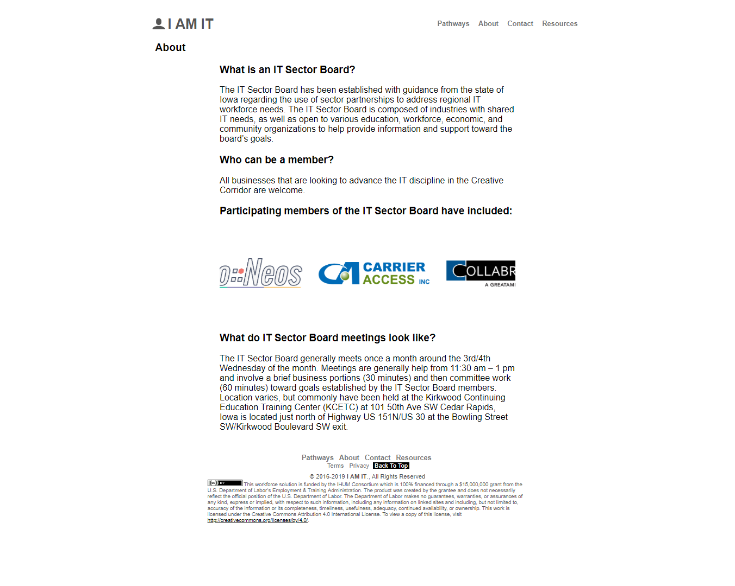
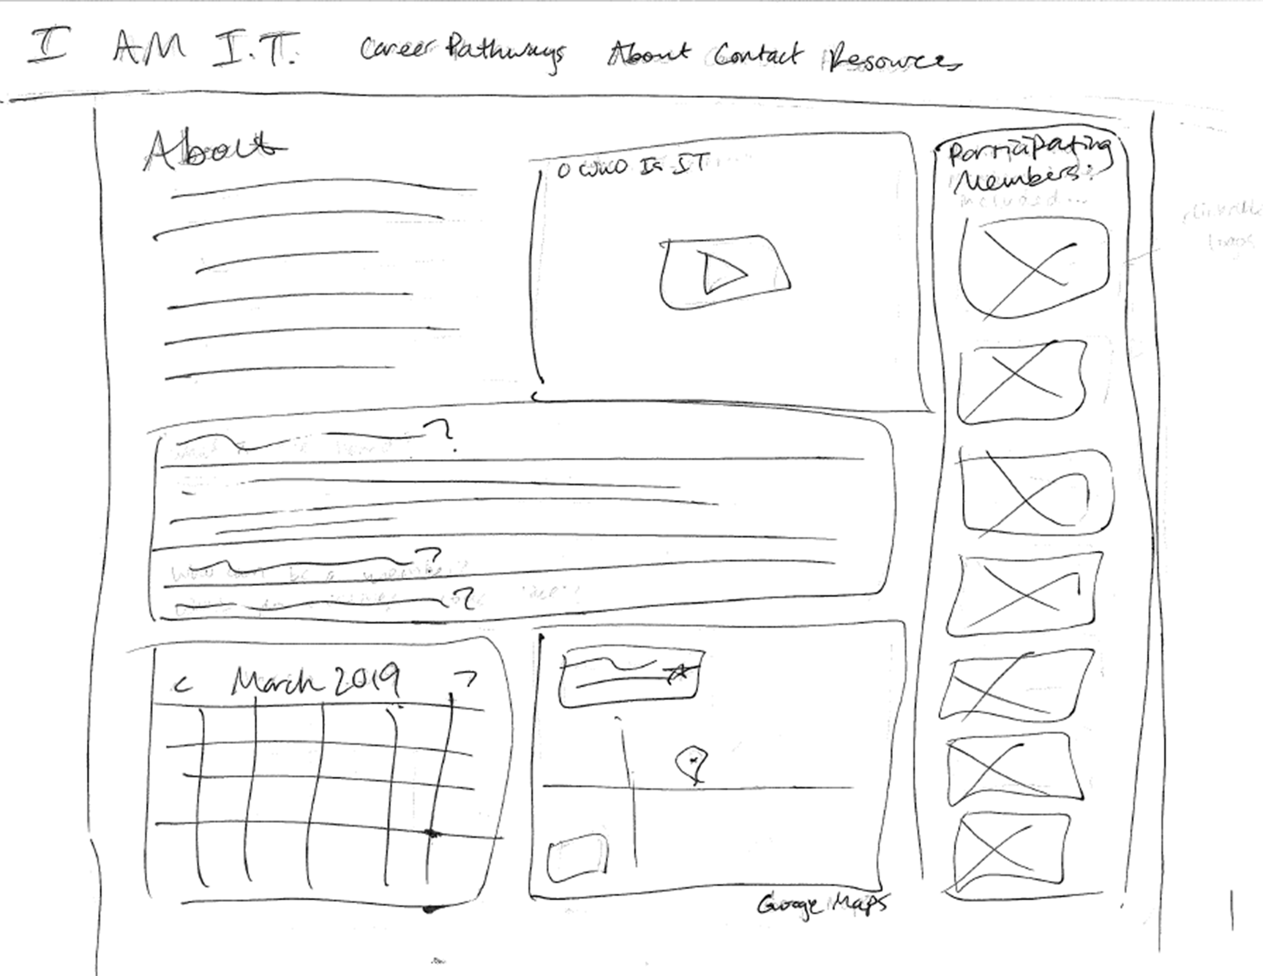
Wireframes - About page

Slide 14
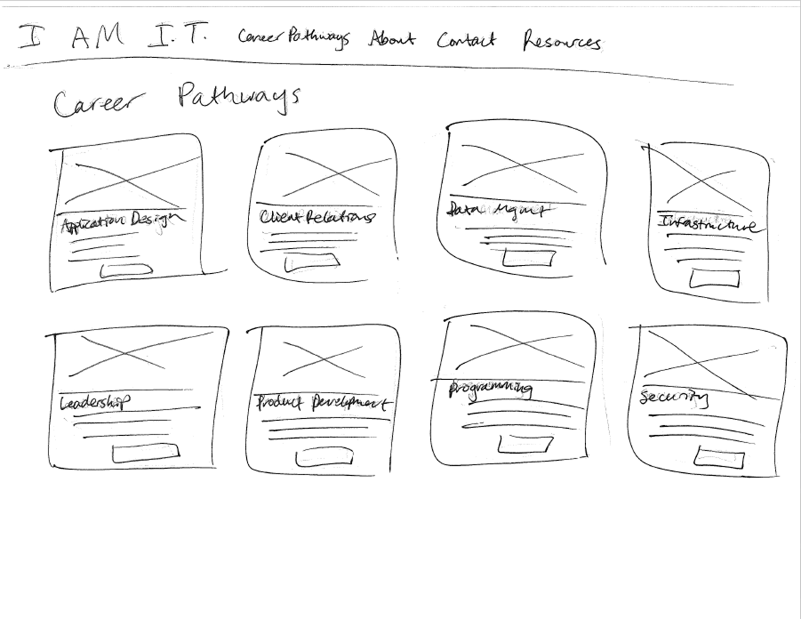
Wireframes - Career pathways page

Slide 15
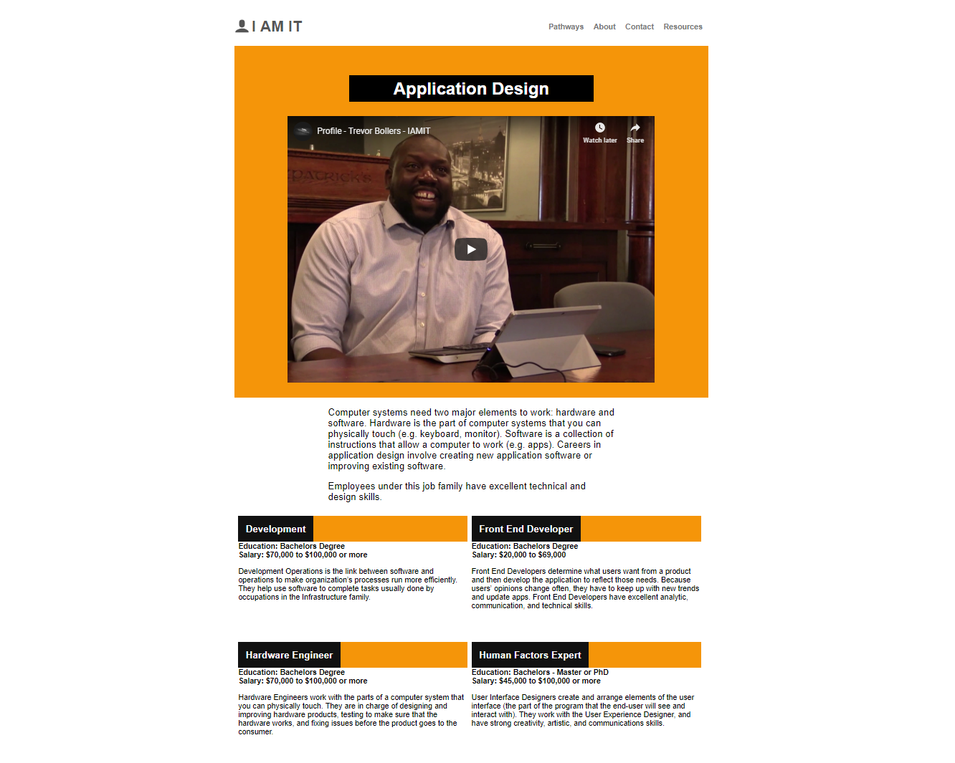
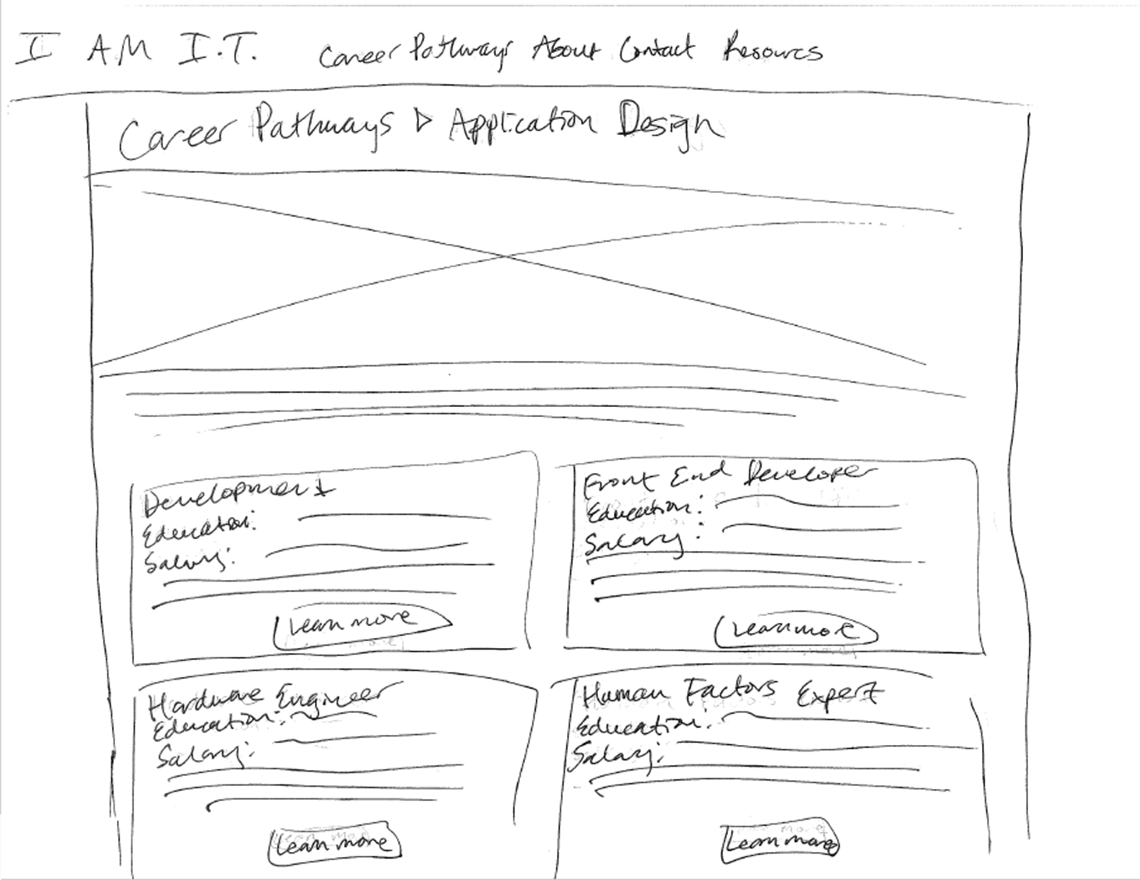
Wireframes - Career category pages

Slide 16
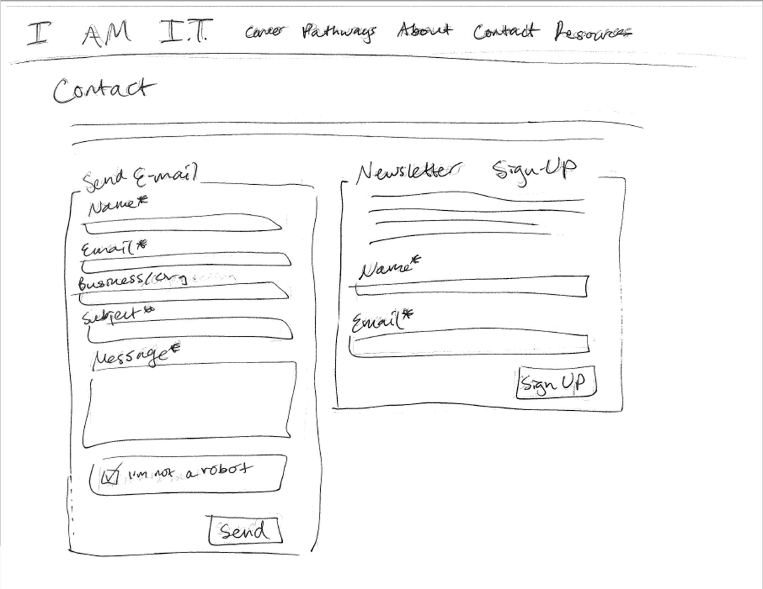
Wireframes - Contact page

Slide 17
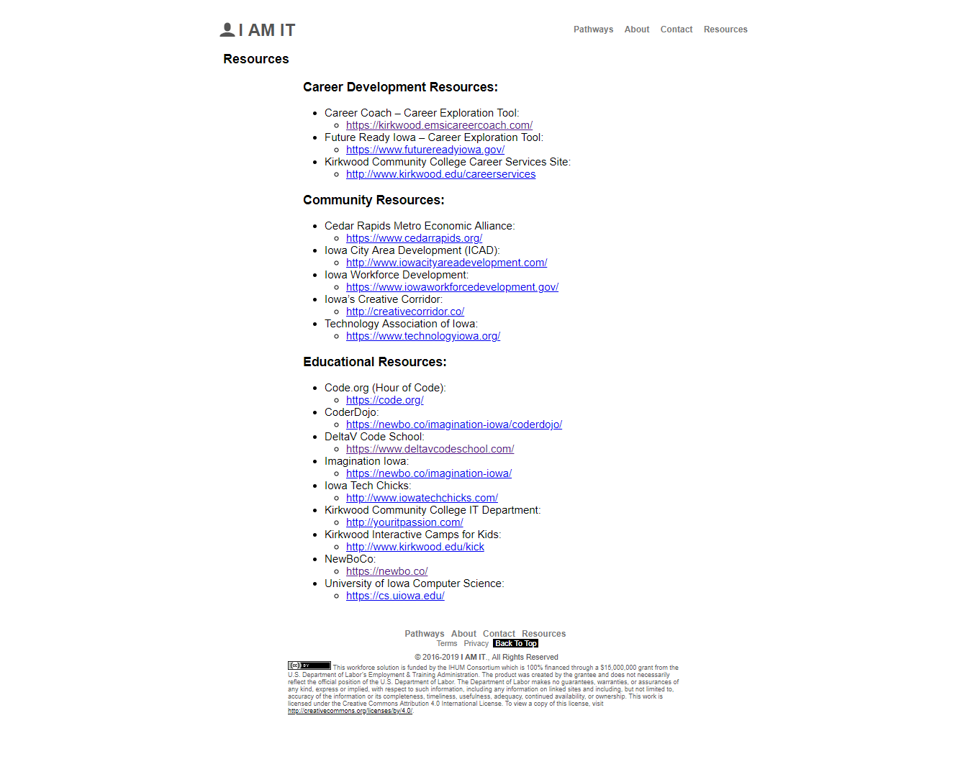
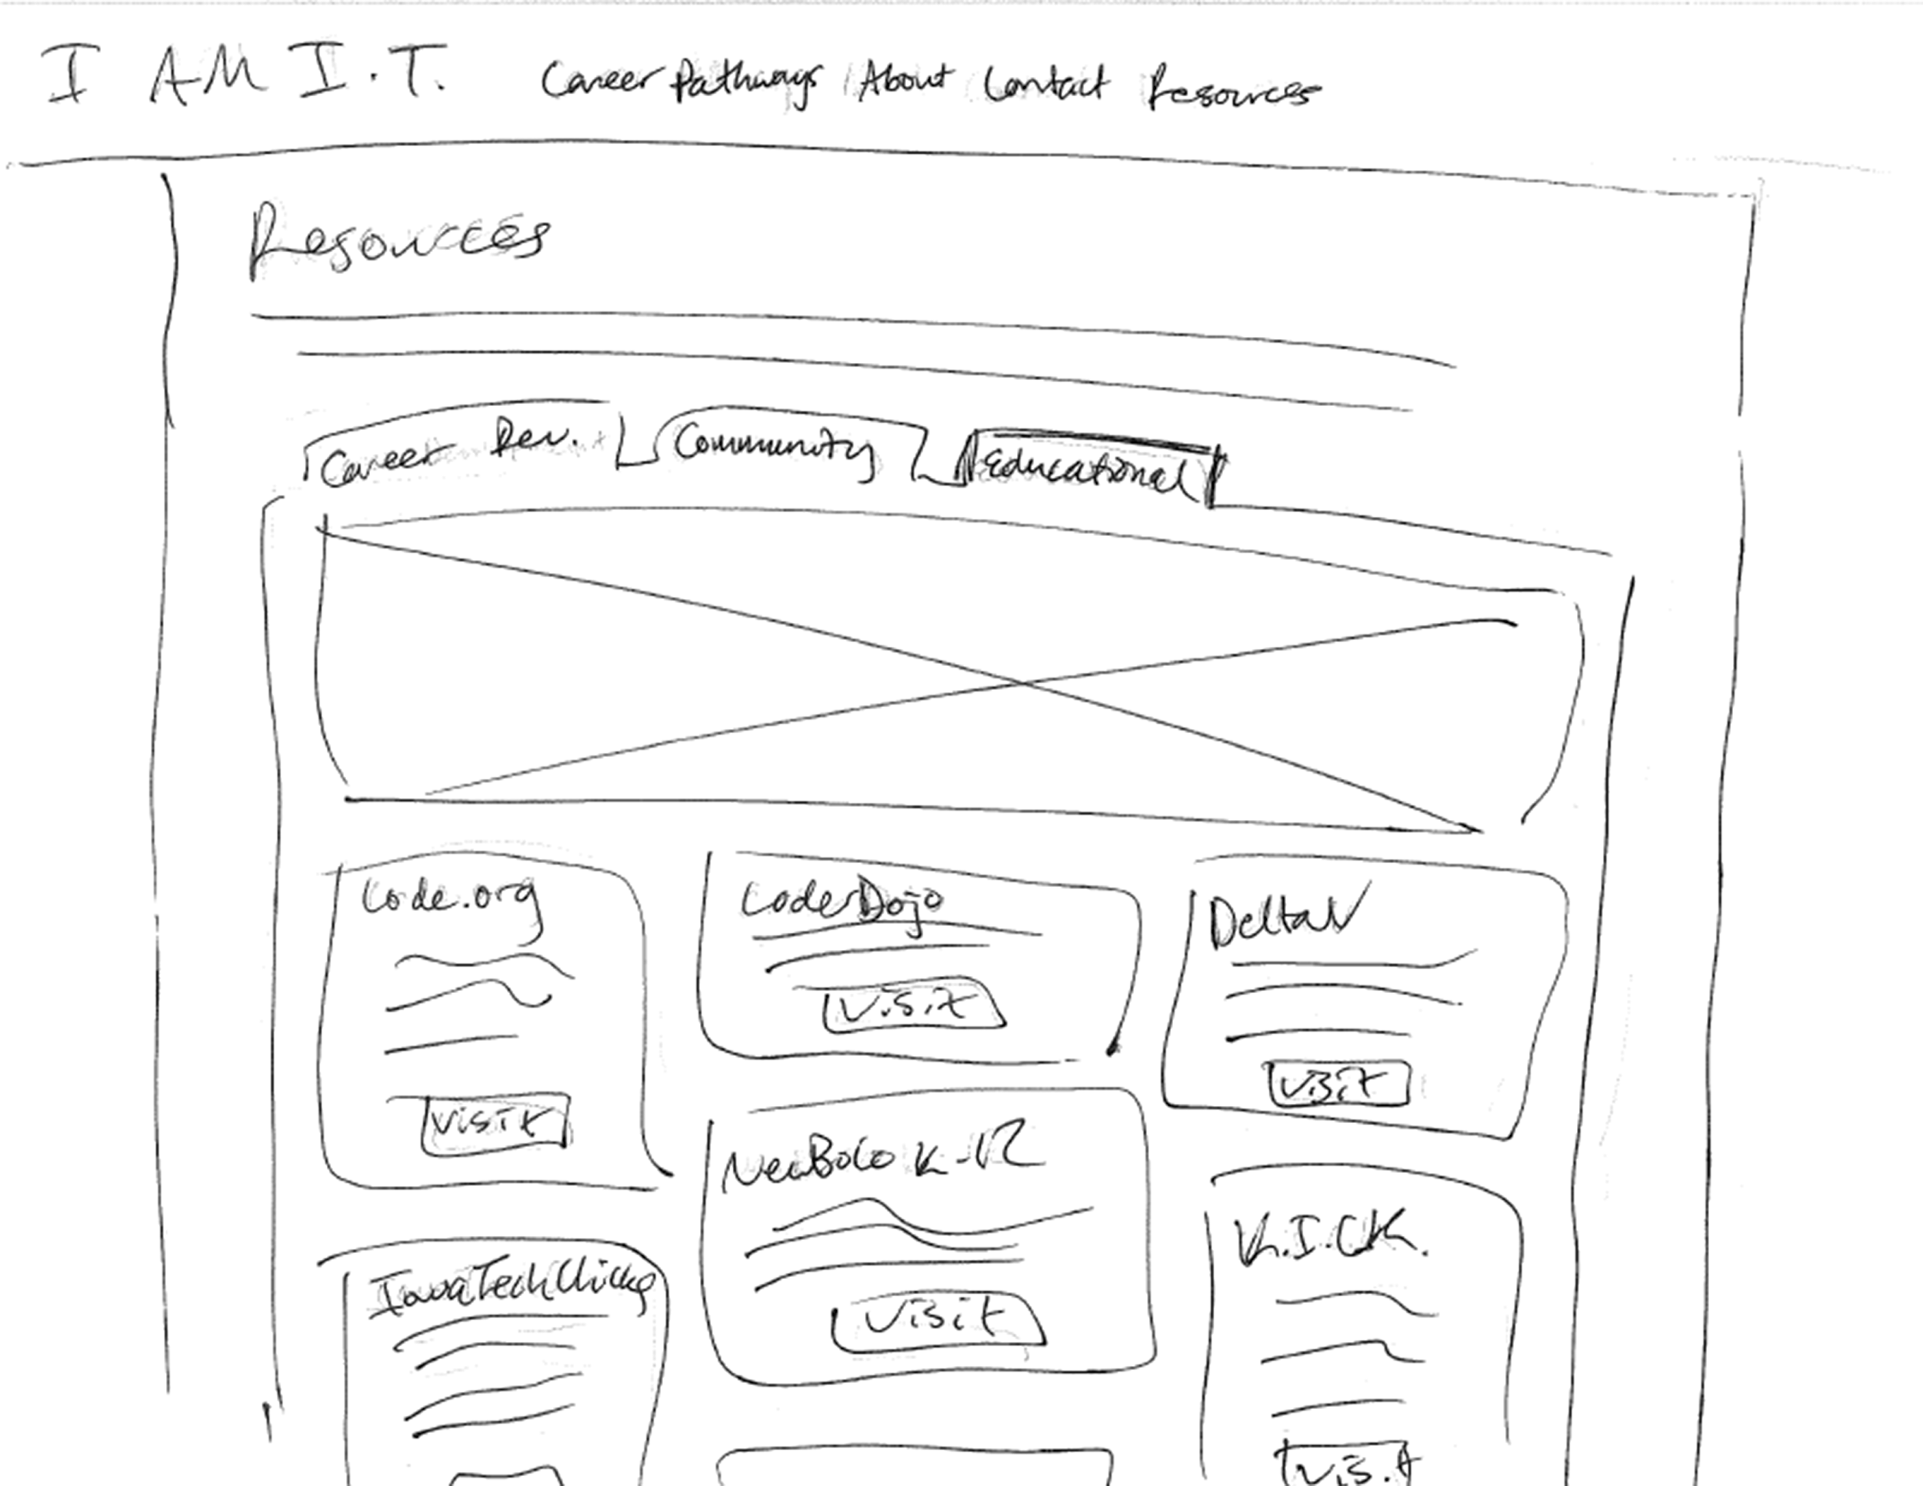
Wireframes - Resources page

Slide 18
The execution...

